Slide 1
Group G
Ryan Klugman
Bowei Liu
Isabel Barlow

Slide 2
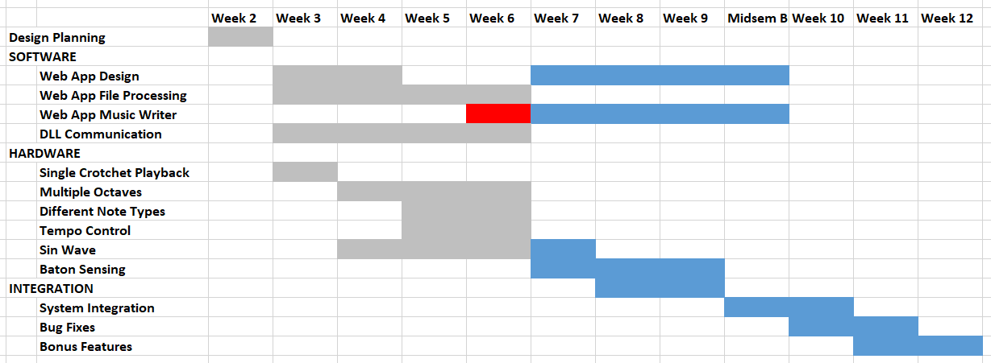
Gantt chart

Slide 3
Progress
People tend

